Slide 1


Slide 2
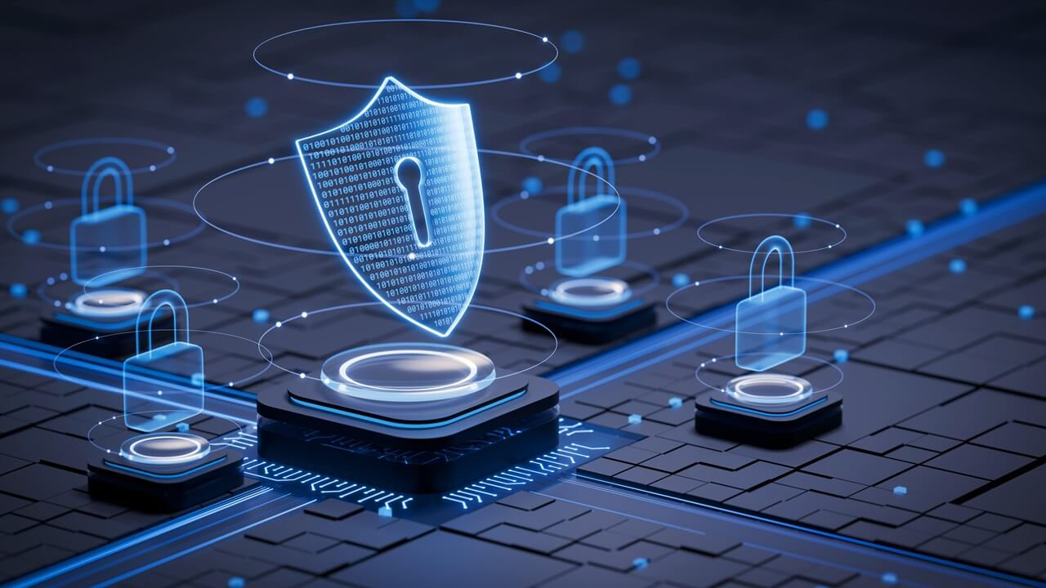
CYBER SECURITY
Protecting Our Digital World
Presented By : Sujeet Kumar, Ujwal Kumar,
Shekhar Kumar, Ashby Choudhary
B.Tech CSE | Roll No : 93,65,63,99
College : NSIT , Bihta
ENGINEER’S DAY
2026
1

Slide 3

1. What is Cyber Security?
The basic idea
• Cyber security is the practice of protecting computers, networks, applications and data from digital threats.
• It keeps information confidential, accurate and available to authorized users.
• It is important for students, individuals, businesses, banks and governments.
2

Slide 4
2. Why is Cyber Security Important?
Security affects everyday digital life
🔒 Privacy
💾 Data Protection
Keeps personal information away from unauthorized people.
Prevents loss, alteration or theft of important data.
₹ Financial Safety
✓ Trust
Reduces risks from online fraud and scams.
Makes online services safer and more reliable.
3

Slide 5
3. Common Cyber Threats
Know the major types of attacks
🎣 Phishing
🦠 Malware
⚠ Ransomware
Fake messages or websites designed to trick users.
Harmful software such as viruses and spyware.
Malware that can lock data and demand
Payment.
🔑 Password Attacks
👤 Social Engineering
Attempts to guess, steal or reuse passwords.
Manipulating people into revealing information.
4

Slide 6
4. Types of Cyber Security
Different layers protect different assets
🛡 Network Security
🛡 Application Security
🛡 Information Security
Protects networks from unauthorized
access.
Secures software and apps against
vulnerabilities.
Protects data in storage and during transfer.
🛡 Cloud Security
🛡 Mobile Security
Protects cloud services, accounts and
resources.
Protects smartphones, tablets and mobile data.
5

Slide 7
5. How a Cyber Attack Can Happen
A simple attack chain
→ 1. Fake Link
→ 2. Click
→ 3. Exploit
→ 4. Damage
User receives a suspicious
message.
User opens the link or
attachment.
Attacker takes advantage of a weakness.
Data, accounts or systems may be affected.
6

Slide 8
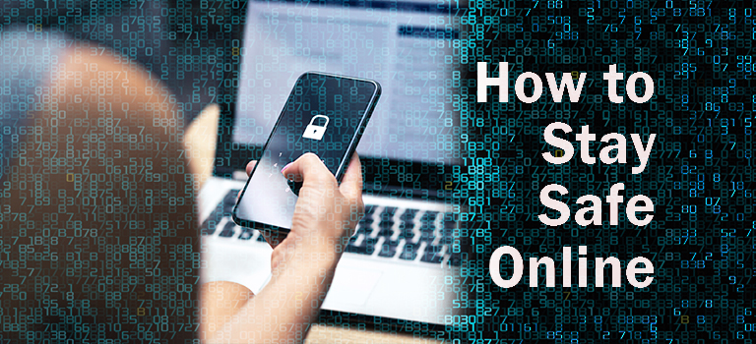
6. How to Stay Safe Online
Simple habits make a big difference
• Use strong, unique passwords and never share them.
• Turn on two-factor authentication (2FA) wherever possible.
• Do not click unknown links or download unexpected files.
• Keep your operating system, browser and apps updated.
• Back up important files and use trusted networks and websites.
7

Slide 9
7. Cyber Security in Daily Life
Where we use it every day
💳 Online Banking
📱 Social Media
✉ Email
Cyber security helps protect these digital activities.
Cyber security helps protect these digital
activities.
Cyber security helps protect these digital activities.
🛒 Online Shopping
📲 Smartphones
🎓 College Systems
Cyber security helps protect these digital activities.
Cyber security helps protect these digital
activities.
Cyber security helps protect these digital activities.
8

Slide 10
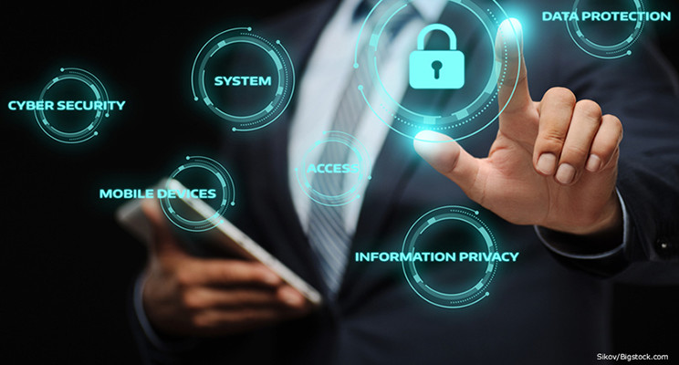
8. Benefits of Cyber Security
What good security provides
✓ Benefit 1
Protects personal and organizational data.
✓ Benefit 2
Reduces risk of cyber attacks.
✓ Benefit 3
Supports privacy and safe communication.
Helps prevent financial and operational losses.
✓ Benefit 4
✓ Benefit 5
Builds confidence in digital services.
9

Slide 11

9. Conclusion
Cyber security is everyone's responsibility
• Cyber security protects our devices, data and digital identity.
• Most security problems can be reduced by careful online behavior.
• Think before you click, protect your accounts and keep your software updated.
ANY QUESTION
10

Slide 12

THANKYOU

